Slide 1
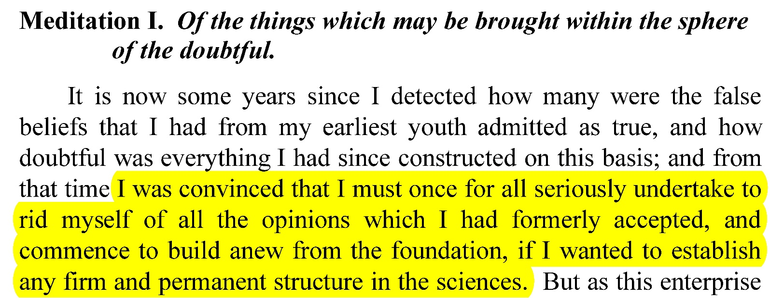
Meditation One
What is the objective of the Meditations?
Hint: look at first sentence of Med. I.

Slide 2
How do we know he is after Absolute Knowledge (K*)?
Hint: He wants to avoid the possibility of any future mistakes in science
like those we made in the past (Aristotle on falling bodies, for example).
How do we get K*? How do we know when we have it?
RD’s Answer: ‘certainty of belief’

Slide 3
1) What is this "certainty"? A feeling of confidence?
Unlikely. In 1938, Neville Chamberlain came back from a meeting with Hitler confident that he had an agreement that was ensure “Peace in our Time”. This didn’t work out so well, for Europe, or much of the rest of the world in World War II!
2) A very strong, even extremely confident feeling?
When former President Trump tweets “I am a stable genius!”, and is strongly confident this is true, does he then know it? Is it therefore true?
3) Then does certainty of belief = "verified belief"?
Maybe. Right now, I believe it is 3:30 pm because my Garmin watch says so, and it keeps reliable time being connected by satellites to a cesium clock.
4) But, what if my watch still reads 3:30 pm five minutes from now? Was I justified in believing it was 3:30 pm originally?
Doesn’t seem so. The reliability of my watch depends on its continuing accuracy.
5) Then what provides verification that overcomes the
possibility of error? RD’s proposal: objective certainty.

Slide 4
RD: one way of getting at objective certainty of belief is to show what instances of K* look like, then say “that's what certainty gets at.” We head in that direction by first considering what beliefs that are NOT K* look like.
A belief that is not false (truth seems to be a property of beliefs we count as instances of knowledge).
It is not what I do not believe. But is true belief knowledge?
No. But maybe justified true belief (JTB) is knowledge?
But my belief that it was 4:29 pm in class the other day had a justification (the past record of my watch’s accuracy), and was true, but we decided it was not K*.

Slide 5
What more do we need in order to convert JTB into knowledge?
Well, it must be some additional property of the belief. Call this property X. So K* = JTB + X.
How do we discover what "X" is?
RD thinks objective certainty is the mark of K*, and it seems to him that objective certainty is the property of any belief that cannot be doubted. So perhaps X = ‘a justified true belief that cannot be doubted’?

Slide 6
Is this indubitability just the name for a psychological state we fall into when believing some things...an inability to bring ourselves to the psychological attitude of doubting?
–No. The inability to doubt must be something arising in the intellect alone. It is not a psychological state, but rather a property of a belief such that it is conceptually beyond doubting. The impossibility of this doubt is rather more like the impossibility of confirming that a round square is possible (RD has an argument for the general claim that any belief that cannot be doubted by the intellect [for example, “A is A”; “Round squares are impossible”] must be true),

Slide 7
RD’s Method of Doubt
Find some beliefs about the world which are indubitable, then derive, as in a geometric deduction, any other true beliefs about the world from those. RD’s Method of doubt acts as a filter for our dubitable beliefs.
RD generates general doubt about our common beliefs (including, eventually, mathematical propositions!) with a Three Step sceptical attack
that comes in Two Phases

Slide 8
Phase 1
Generate a fully general doubt about all sensory beliefs.
Step One: Sense perception is prone to occasional errors/vulnerable to perceptual illusions. Is that grounds for doubting all sense beliefs? NO!
Step Two: Since my evidence for beliefs based on waking sense perceptions is the same as that in a vivid dream, I have no basis for trusting waking perceptions as veridical.
Does this place all sensory beliefs in doubt?
NO. RD’s Painting Analogy remains (what’s that, and what consequences does it have?)

Slide 9
Phase 2
Generate a fully general doubt about all sensory beliefs, including those that remain unchallenged by the dream hypothesis, AND a fully general doubt about all mathematical beliefs
Step Three: the Evil Demon Hypothesis (EDH). This is the thought that there could be a godlike, but evil being that is generating all of my sensations and causing my thinking to be defective, but I am completely unaware of this. Since my sense perceptions are not caused by what I think they are caused by, all my sense beliefs could be false. And since mathematical beliefs depend on reasoning, if my thinking has a built-in defect that is hidden from me, then I couldn’t trust any of those beliefs either.

Slide 10
What beliefs remain intact if we assume the EDH is true?
NONE.
Epistemic Vertigo.
Maximal uncertainty in our beliefs.
What is left to us but ‘cognitive despair’?

